Slide 1



Insurance Data Analytics
A comprehensive business intelligence project leveraging Excel, SQL, Tableau, and Power BI to transform raw insurance data into actionable insights for strategic decision-making.
Tools & Technologies
Microsoft Excel, SQL, Tableau, Power BI
Project Team
Abhijit Anil Tele
Sandesh Pothuraju
Swarali Mahakal
Namoju Sowmya
R Gnapika

Slide 2
PROJECT OVERVIEW
Transforming Insurance Data into Business Intelligence
Our Mission
Methodology
Analyze insurance business data to generate meaningful insights spanning premium performance, claims analysis, customer segmentation, and overall business growth patterns.
Cleaned and structured raw insurance datasets for analysis
Calculated critical KPIs using advanced SQL queries
Built comparative dashboards across Excel, Tableau, and Power BI
Delivered interactive visualizations supporting data-driven decisions
Dataset Overview
Data Source: Insurance operational database
Tables Used: Customers, Policies, Claims,Payments
Time Period: 2014 – 2024
Records: 5,000 policies, 3,100 customers

Slide 3

Key Performance Indicators & Business Metrics
Our comprehensive analytics framework tracks ten essential KPIs that provide 360-degree visibility into insurance operations, customer behavior, and financial performance.
Volume Metrics
Financial KPIs
Operational Efficiency
Strategic Insights
Total Policies, Total Customers
Total Premium Amount, Total Claim Amount, Premium Growth Rate
Claim Approval Rate, Payment Status Analysis
Customer Segmentation, Policy Distribution, Retention Trends

Slide 4
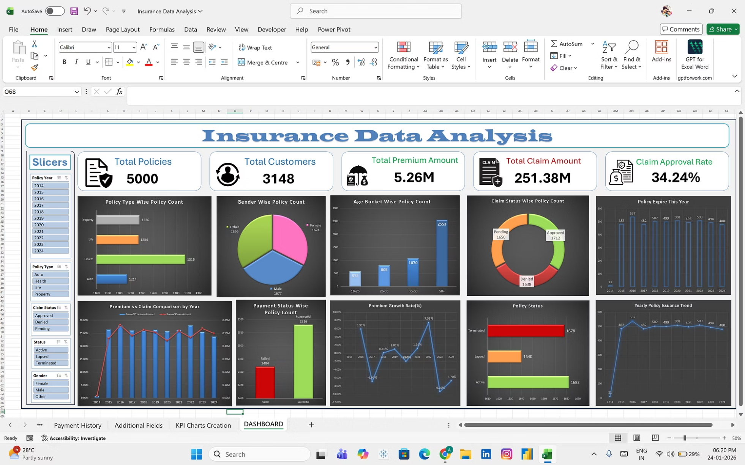
EXCEL DASHBOARD
Microsoft Excel: Initial Data Exploration
Foundation of Analysis
Our Excel dashboard provides the initial framework for insurance data analysis, featuring essential visualizations including policy distribution, premium trends, and customer demographics.
Key features include pivot tables for dynamic analysis, conditional formatting for quick insights, and interactive charts that facilitate preliminary data exploration and hypothesis generation.

Slide 5
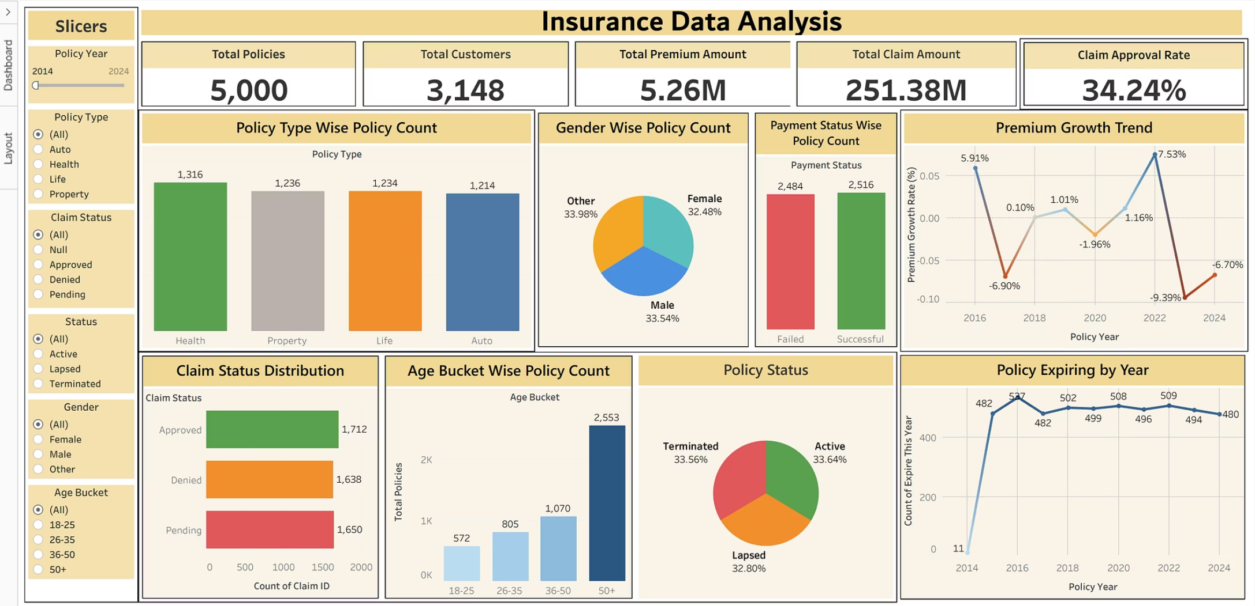
TABLEAU VISUALIZATION
Tableau: Interactive Data Discovery
Enhanced Interactivity
Tableau elevates our analysis with sophisticated interactive visualizations that enable stakeholders to explore data relationships through intuitive filters and drill-down capabilities.
The platform's strength lies in its ability to reveal hidden patterns through visual analytics, supporting ad-hoc analysis and collaborative exploration of complex insurance datasets.

Slide 6
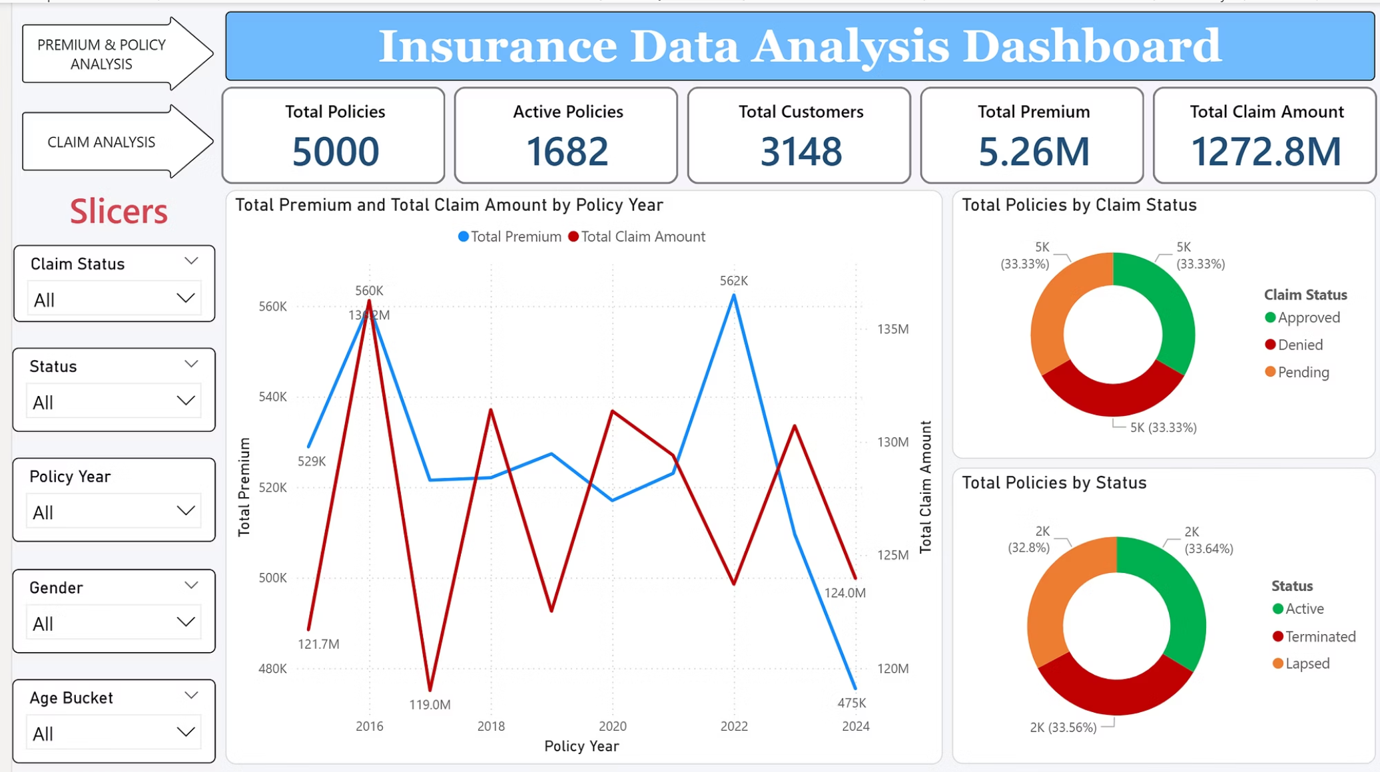
POWER BI DASHBOARD
Power BI: Comprehensive Business Intelligence
Enterprise-Grade Analytics
Power BI delivers our most sophisticated analysis layer, integrating advanced DAX calculations, predictive analytics, and real-time data refresh capabilities for enterprise decision-making.
The dashboard features comprehensive KPI cards, trend analysis, customer segmentation heat maps, and policy performance scorecards—all optimized for executive consumption.

Slide 7
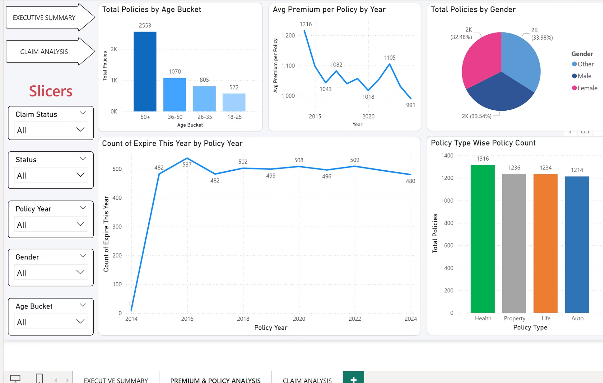
POWER BI DASHBOARD
Multi-Platform Analytics: Strengths & Applications
Strategic Tool Selection
Excel: Ideal for initial exploration, quick analysis, and stakeholders comfortable with spreadsheet interfaces.
Tableau: Best for interactive storytelling, exploratory analysis, and visual-first presentations to diverse audiences.
Power BI: Optimal for enterprise deployment, real-time monitoring, and integrated reporting within Microsoft ecosystems.

Slide 8
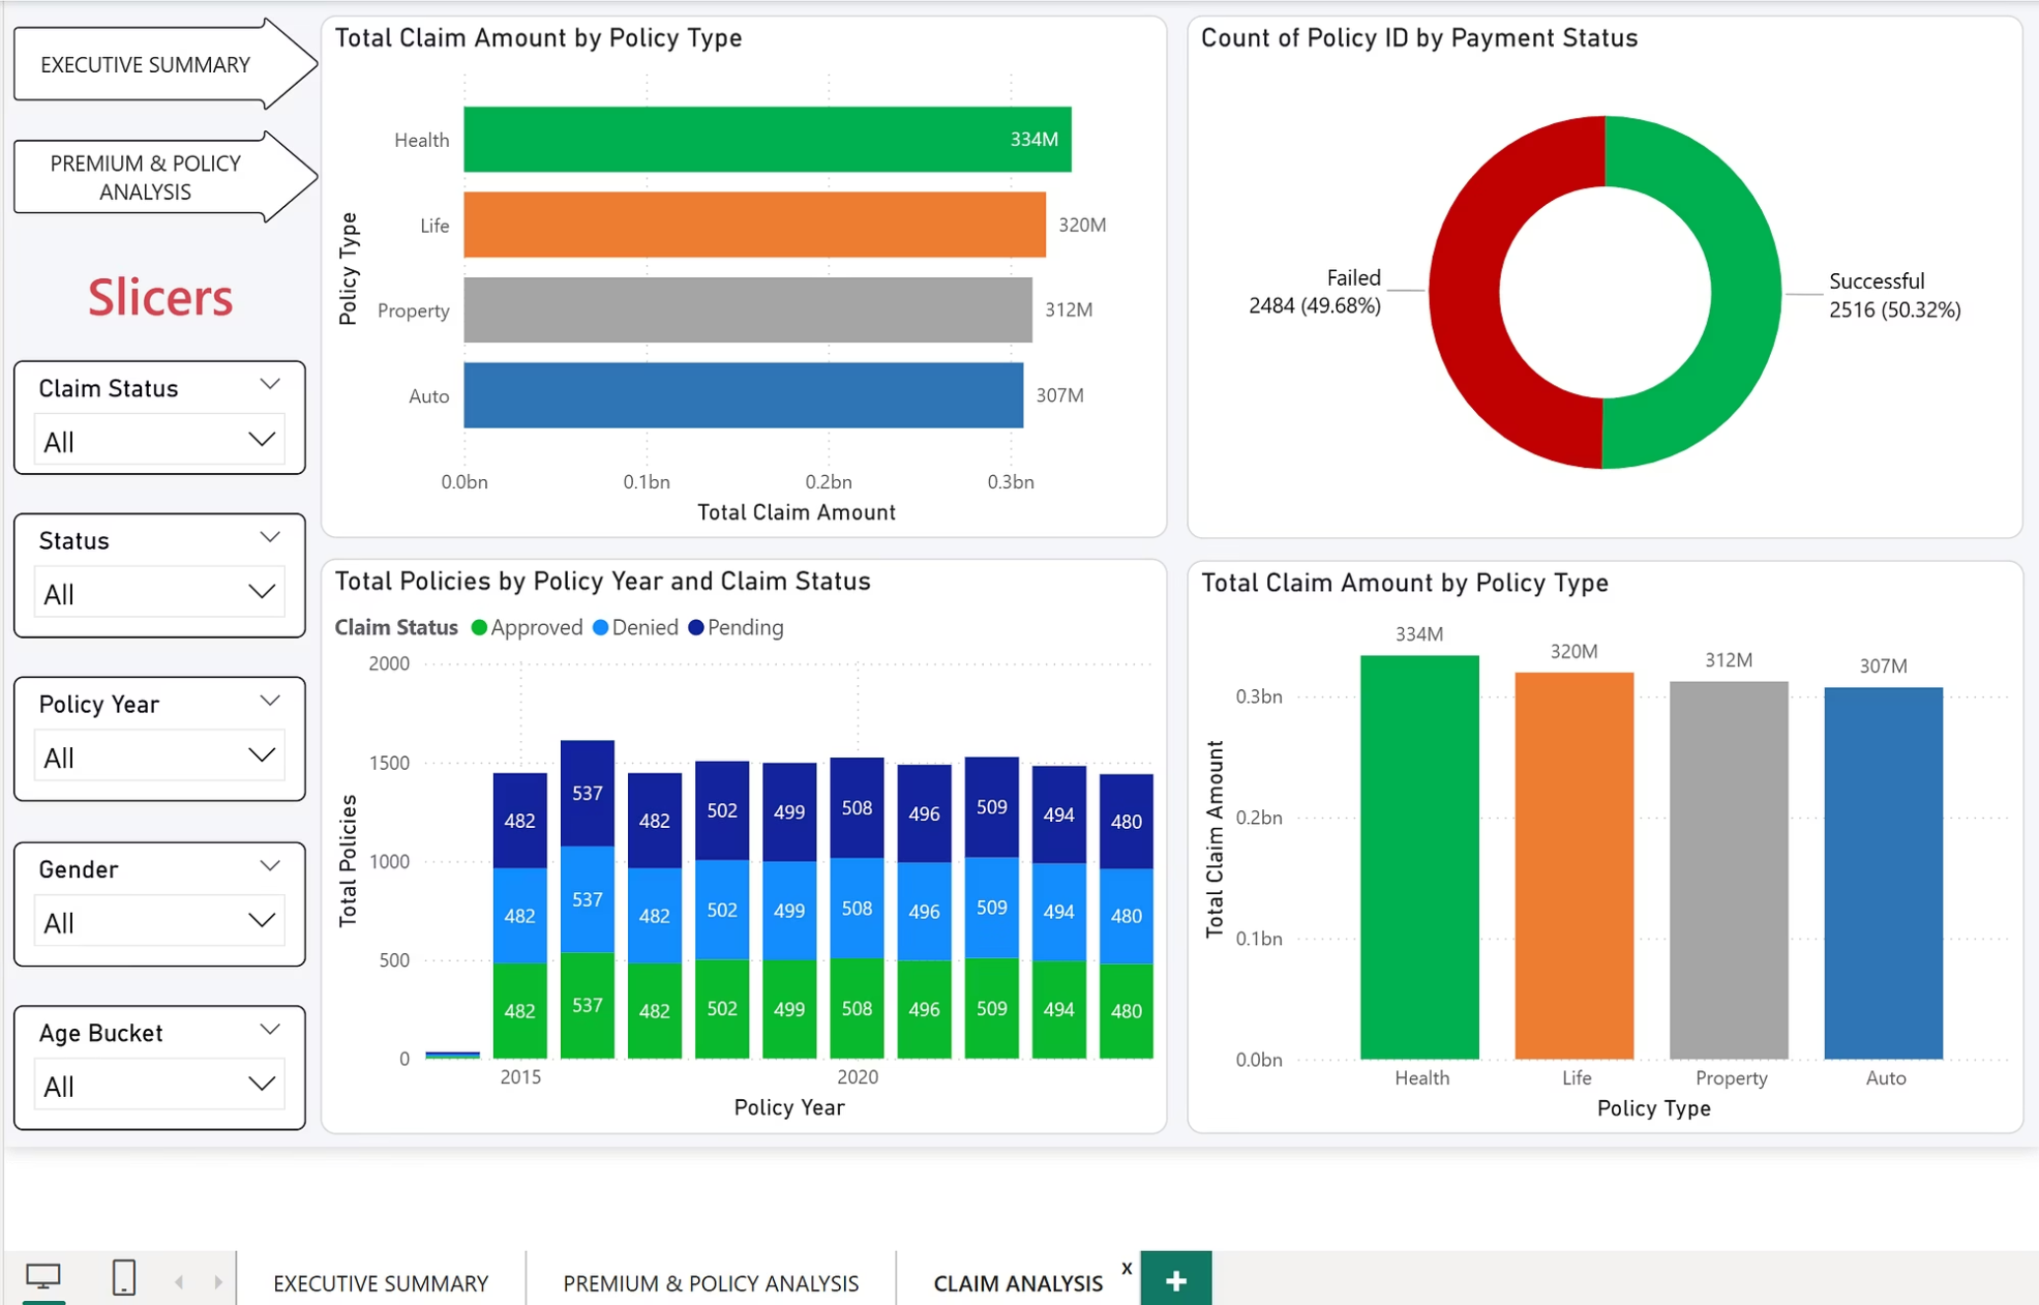
POWER BI DASHBOARD
Advanced Dashboard Capabilities
Technical Excellence
Our dashboards incorporate advanced features including dynamic filtering, cross-visualization interactions, custom calculations, and responsive design principles that ensure optimal viewing across devices.
Performance optimization techniques ensure rapid data refresh and seamless user experience even with large insurance datasets spanning multiple years and millions of records.

Slide 9
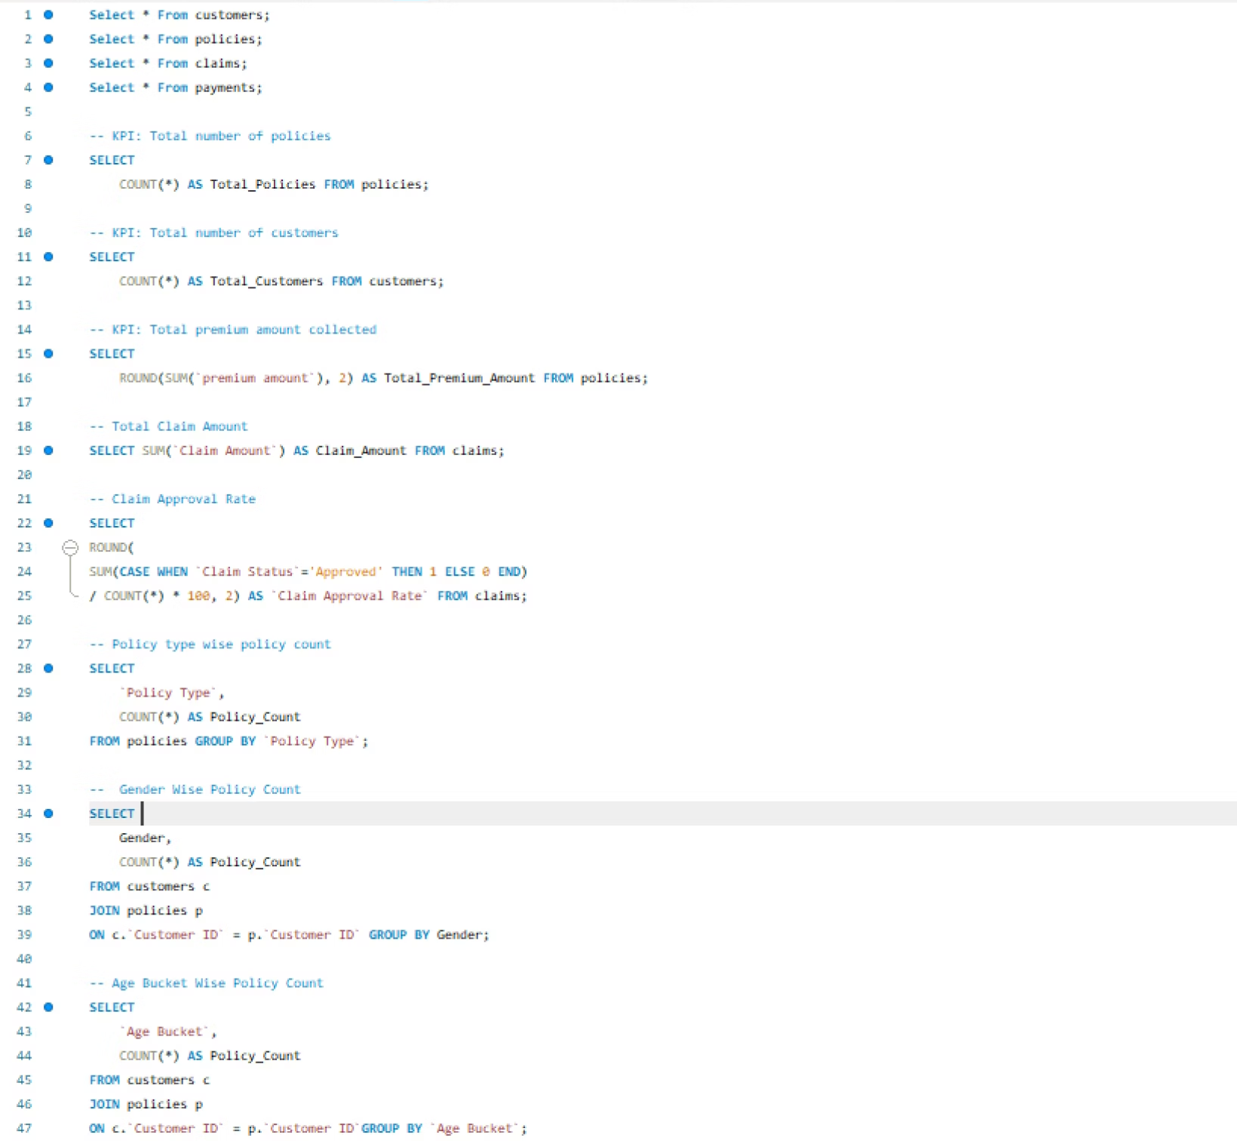
SQL Query Implementation
Data Aggregation Engine
SQL serves as the backbone of our analytics pipeline, performing complex aggregations, joins, and calculations that power all downstream visualizations.
Our query library includes:
Premium and claim aggregations by policy type, region, and time period
Customer segmentation logic based on demographics and behavior
Growth rate calculations using window functions
Claim approval rate analysis with conditional logic

Slide 10
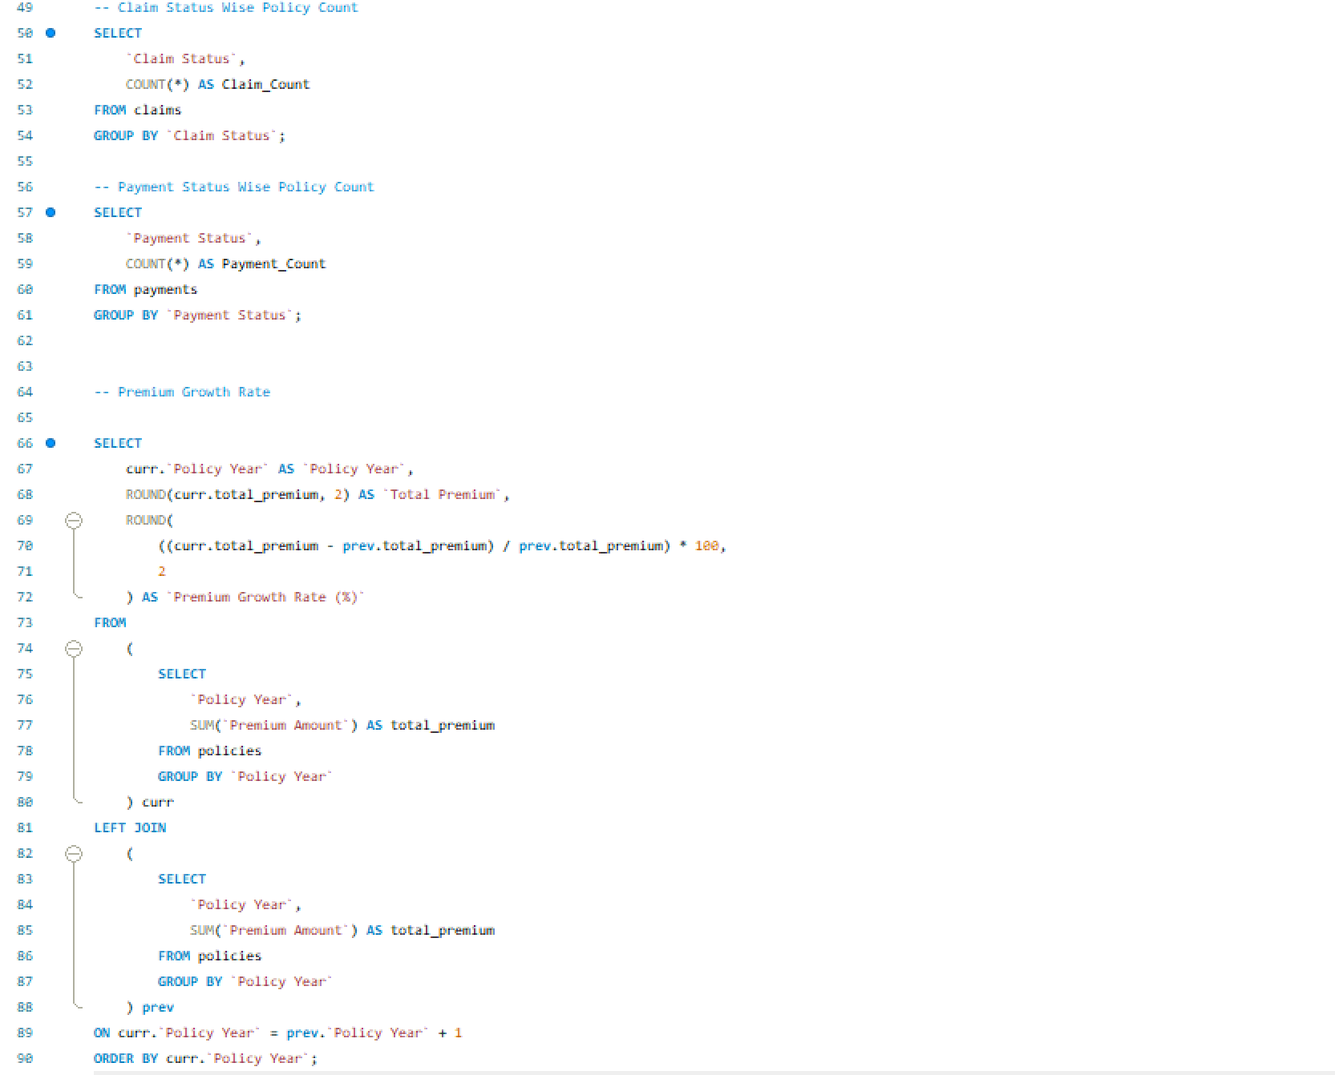
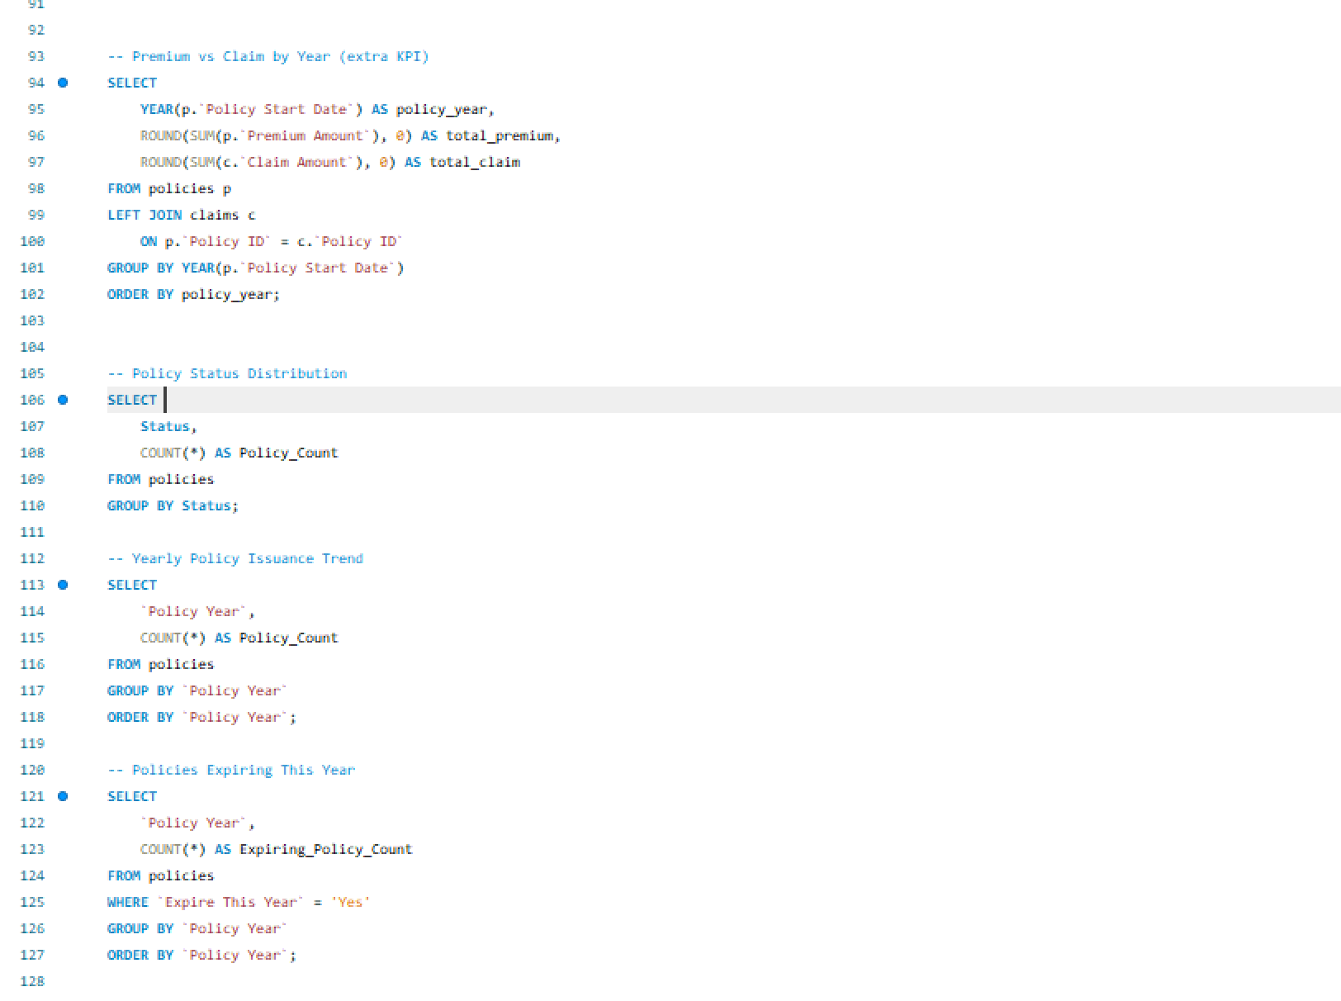

Slide 11




Key Takeaways & Business Impact
Data-Driven Decisions
Customer Insights
Multi-Platform Value
Interactive dashboards enable stakeholders to identify trends, optimize premium pricing, and improve claim processing efficiency.
Demographic and behavioral segmentation reveals opportunities for targeted marketing and product development initiatives.
Comparative implementation across Excel, Tableau, and Power BI demonstrates each platform's unique strengths for different use cases.
This project successfully transforms raw insurance data into actionable intelligence, demonstrating the power of modern BI tools to drive business performance and strategic planning.

